Slide 1
























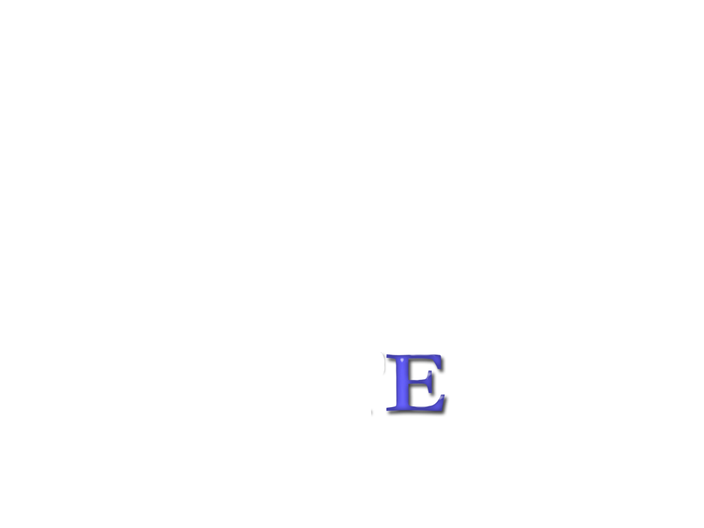

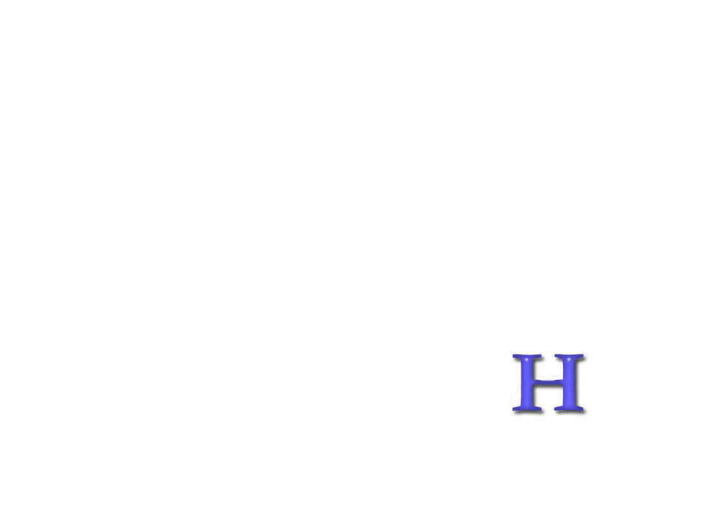





Slide 2



SHOPS ONLINE
M A N U A L

Slide 3






NutriTECH SHOPS ONLINE
M A N U A L
Easy Steps:
1
Open your Internet Browser
Google
Chrome
Internet
Explorer
Mozilla
Firefox
Safari

Slide 4
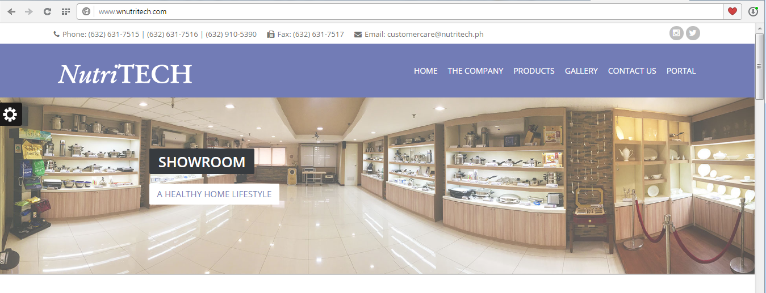
NutriTECH SHOPS ONLINE
M A N U A L
Easy Steps:
2
Open the NutriTECH Official Website
by keying-in www.wnutritech.com
in the browser’s address bar.

Slide 5
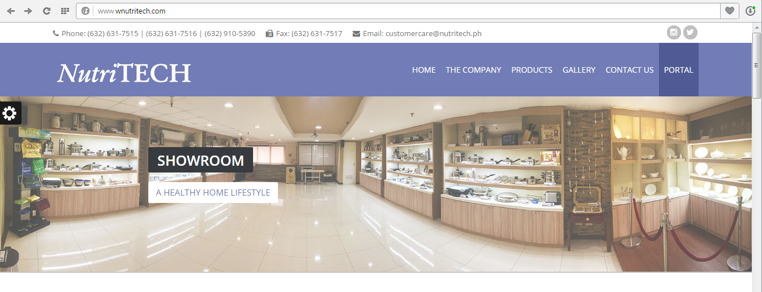
NutriTECH SHOPS ONLINE
M A N U A L
Easy Steps:
3
Once the NutriTECH website shown
your browser, click PORTAL PAGE.

Slide 6
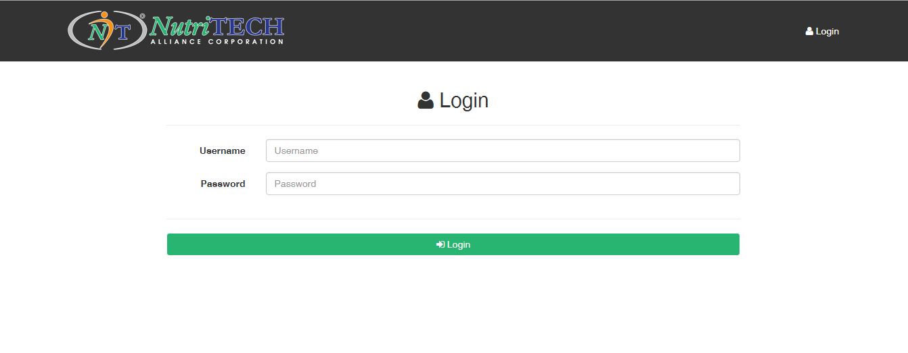
NutriTECH SHOPS ONLINE
M A N U A L
Easy Steps:
4
Sign in using your
NutriTECH Portal Account.

Slide 7
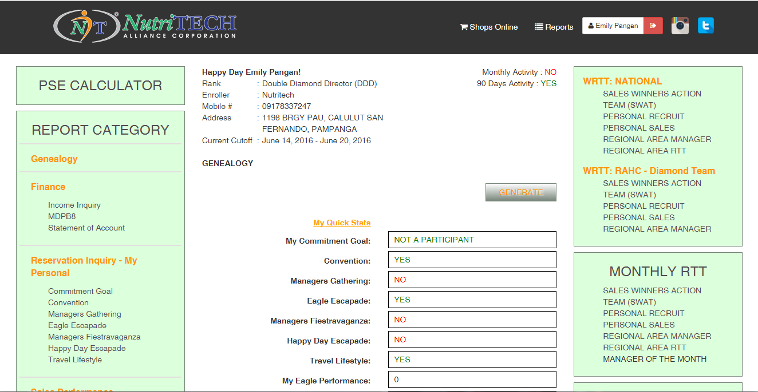
NutriTECH SHOPS ONLINE
M A N U A L
Easy Steps:
5
Once logged in, click SHOPS ONLINE
Located at the upper menu.

Slide 8
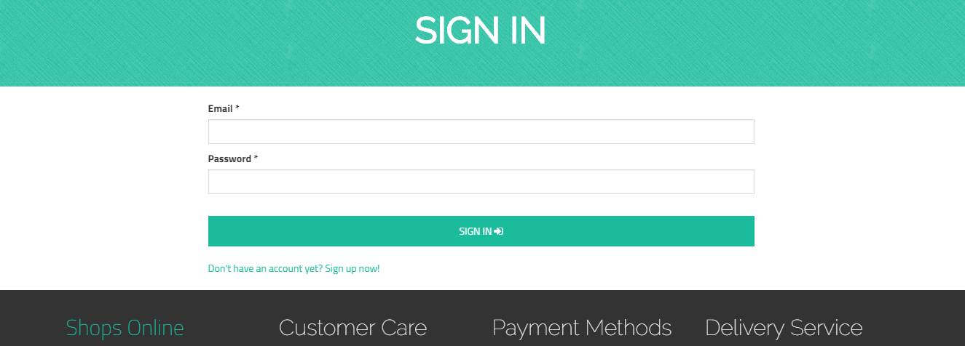
NutriTECH SHOPS ONLINE
M A N U A L
Easy Steps:
ONLINE SHOPPING GUIDE:
How to Register
If you are new and first time in using our
Shops Online, Click Sign up now
6

Slide 9
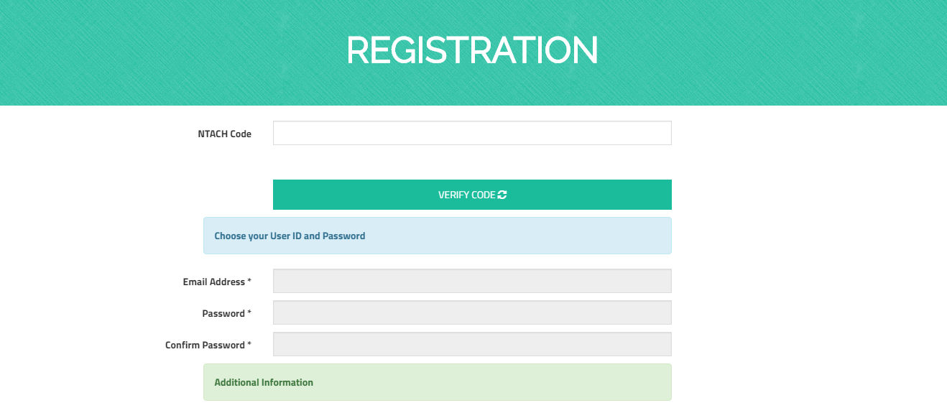
NutriTECH SHOPS ONLINE
M A N U A L
Easy Steps:
ONLINE SHOPPING GUIDE:
How to Register
Fill up all necessary fields. Information with
asterisk (*) are important fields to fill-in
Please be guided, your NTAC CODE is necessary
for you to continue the transaction.
7

Slide 10
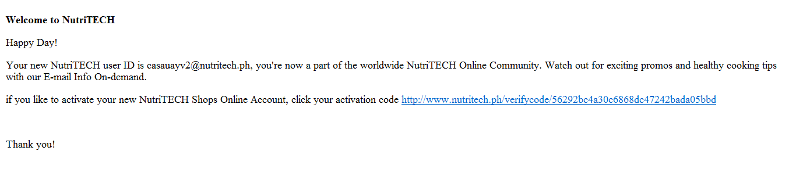
NutriTECH SHOPS ONLINE
M A N U A L
Easy Steps:
ONLINE SHOPPING GUIDE:
How to Register
Shops Online automatically verifies if
Email Address created is valid.
Message will be sent to your email address.
Open your email address
8
Click the link for the activation.
You will be automatically Redirected to shops online home page

Slide 11
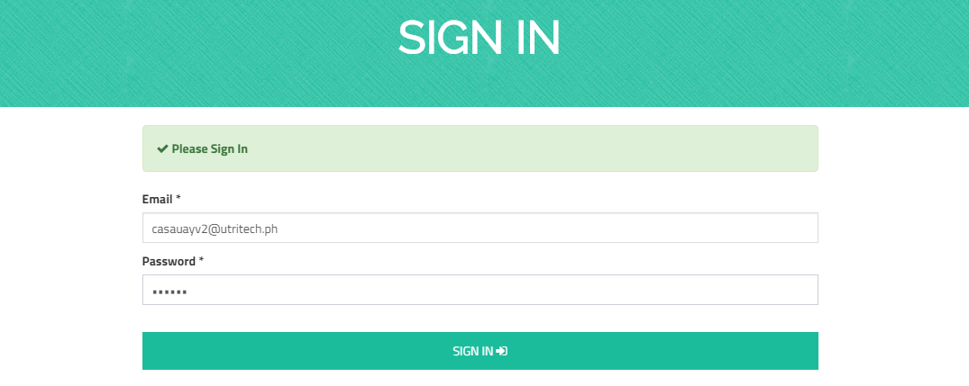
NutriTECH SHOPS ONLINE
M A N U A L
Easy Steps:
ONLINE SHOPPING GUIDE:
Sign In
Enter your email address and password
to Sign In.
9

Slide 12
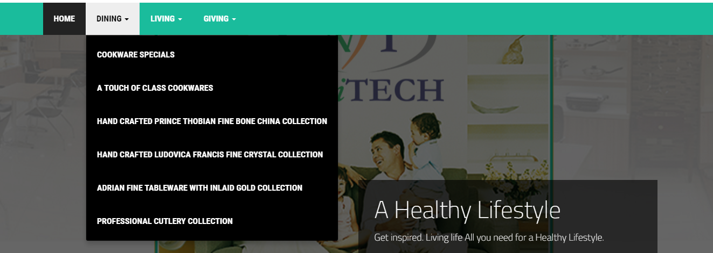
NutriTECH SHOPS ONLINE
M A N U A L
Easy Steps:
ONLINE SHOPPING GUIDE:
Upon signing-in you will be directed to
Shops Online HOME PAGE. Products are
categorized into Dining, Living or Giving.
Choose your desired product/s to invest
10

Slide 13
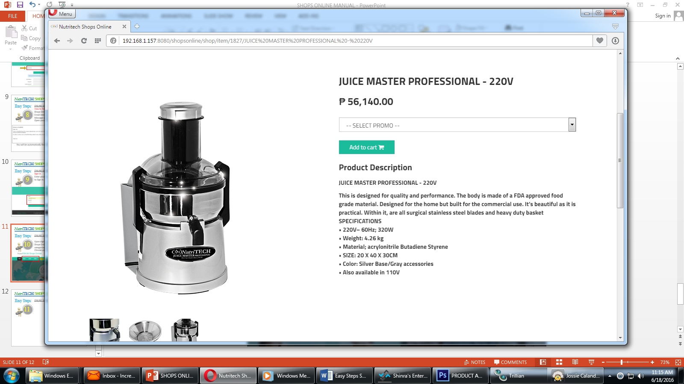
NutriTECH SHOPS ONLINE
M A N U A L
Easy Steps:
ONLINE SHOPPING GUIDE:
Buying an Item
11
There will be a prompt for Selection of Promo.
Click the down arrow to select from the list.

Slide 14
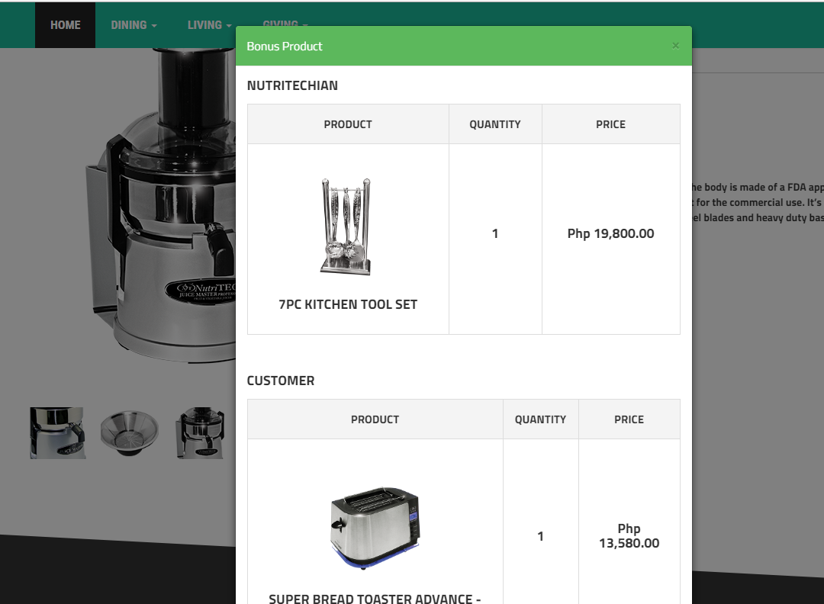
NutriTECH SHOPS ONLINE
M A N U A L
Easy Steps:
ONLINE SHOPPING GUIDE:
Buying an Item
12
Upon selection of promo, the bonus product window will pop-up. It will show the bonus products of Customer & NutriTECHian for that particular promo.

Slide 15
NutriTECH SHOPS ONLINE
M A N U A L
Easy Steps:
ONLINE SHOPPING GUIDE:
Buying an Item
13
A Product Description is shown for specifications of the product.

Slide 16
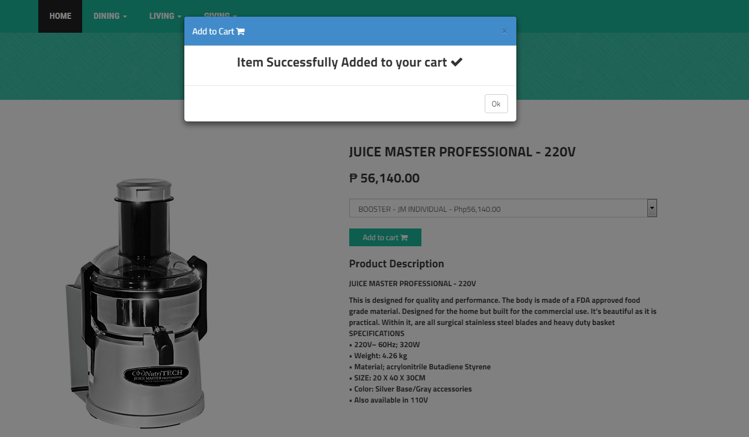
NutriTECH SHOPS ONLINE
M A N U A L
Easy Steps:
ONLINE SHOPPING GUIDE:
Buying an Item
14
Once you are done selecting your order, Click “Add to Cart” button.
Message will appear “Item Successful Added to Cart”
You may continue shopping or proceed to Checkout

Slide 17
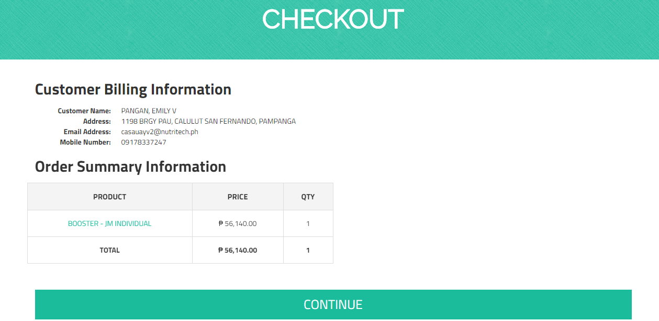
NutriTECH SHOPS ONLINE
M A N U A L
Easy Steps:
ONLINE SHOPPING GUIDE:
Checkout
To validate the details of your profile if correct.
15
Customer Billing Information
Order Summary Information
Click Continue

Slide 18
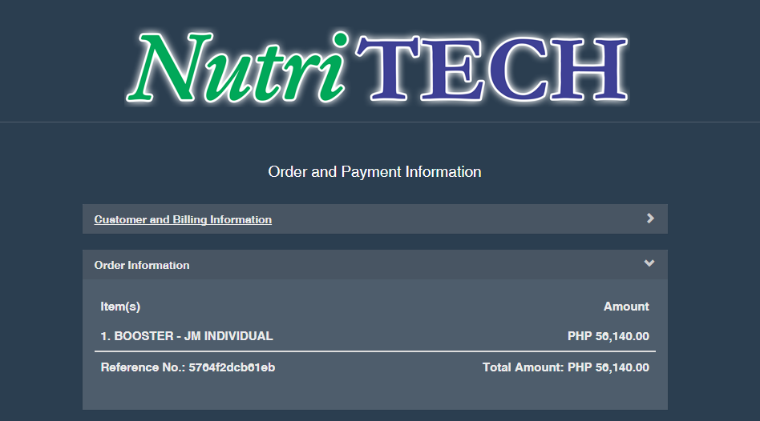
NutriTECH SHOPS ONLINE
M A N U A L
Easy Steps:
ONLINE SHOPPING GUIDE:
Checkout
Order and Payment Information will appear
16

Slide 19
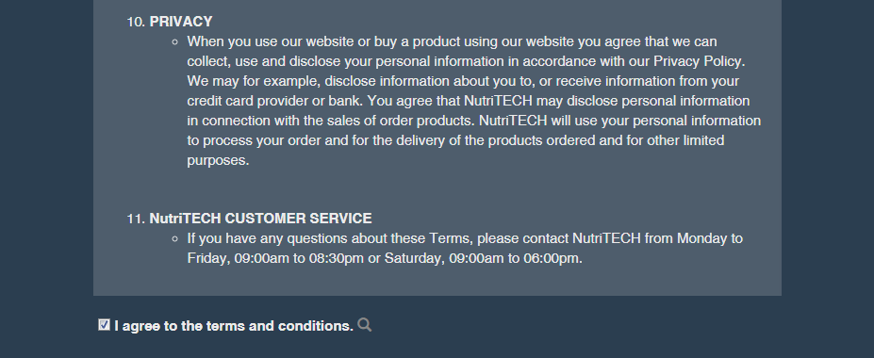
NutriTECH SHOPS ONLINE
M A N U A L
Easy Steps:
ONLINE SHOPPING GUIDE:
Checkout
Click Accept Terms and Conditions
17

Slide 20
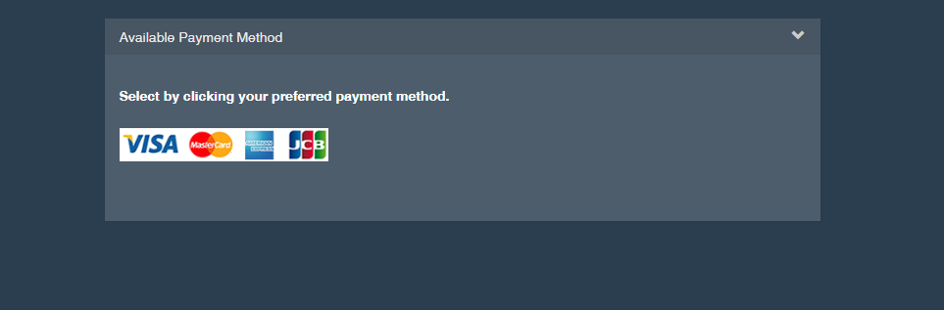
NutriTECH SHOPS ONLINE
M A N U A L
Easy Steps:
ONLINE SHOPPING GUIDE:
Checkout
Click Preferred Payment Method
18

Slide 21
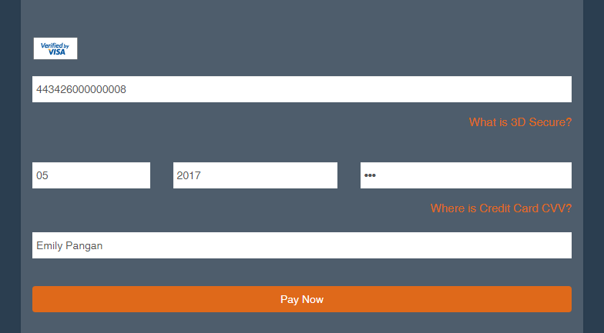
NutriTECH SHOPS ONLINE
M A N U A L
Easy Steps:
ONLINE SHOPPING GUIDE:
Checkout
Payment Procedures via Credit Card
JCB/Amex/Visa/ Mastercard
19
Enter the necessary information including your credit card information.
Once you are done entering necessary information,
Click Pay Now

Slide 22
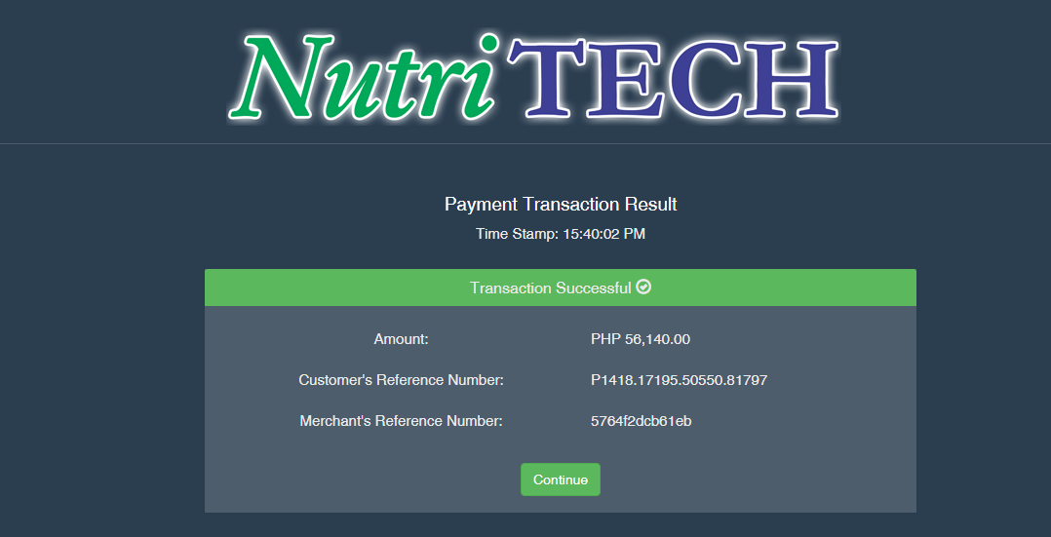
NutriTECH SHOPS ONLINE
M A N U A L
Easy Steps:
ONLINE SHOPPING GUIDE:
Checkout
You will see a confirmation if the
Payment Transaction is SUCCESSFUL or FAILED.
20

Slide 23
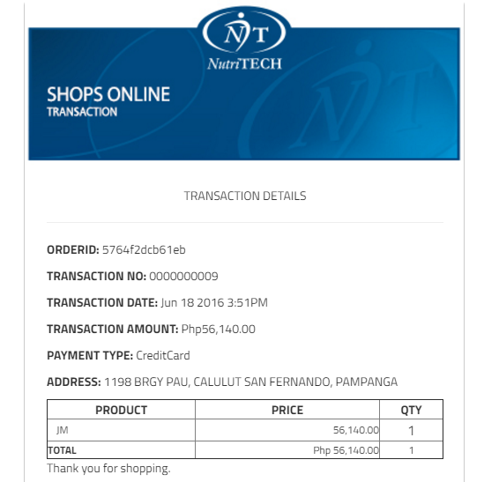
NutriTECH SHOPS ONLINE
M A N U A L
Easy Steps:
ONLINE SHOPPING GUIDE:
21
Transaction Details

Slide 24
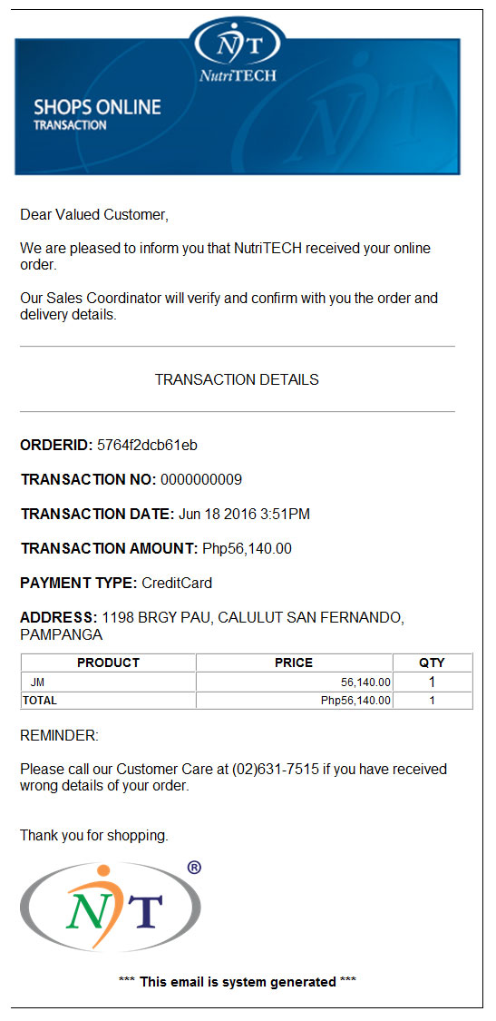
NutriTECH SHOPS ONLINE
M A N U A L
Easy Steps:
ONLINE SHOPPING GUIDE:
22
You will also receive a confirmation receipt through your email address.
Our Sales Coordinator will also contact the customer/NutriTECHian to verify information regarding the successful transaction and
delivery procedures.

